Slide 1


IoT Forum VIIT
presents
Simul - IoT

Slide 2

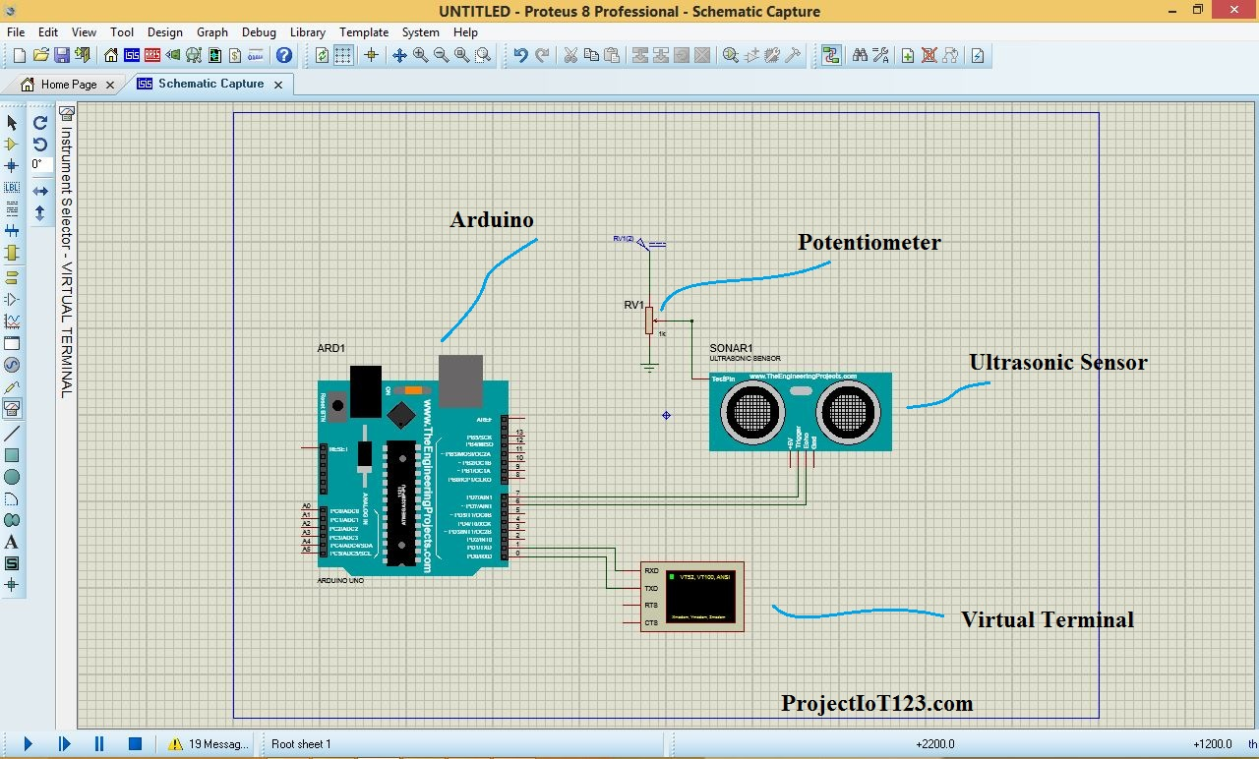
Simul - IoT
Day 1
Introduction to Proteus

Slide 3

What is Simulation???

Slide 4

How does a letter make difference?
Stimulation
Simulation

Slide 5
Stimulation
And
Simulation
To stimulate something is to encourage it to do something. ... Or you can stimulate someone's interest in a given subject.
the action of arousing interest, enthusiasm, or excitement.
To simulate is to pretend something or to try to duplicate something in a way that is not actually real.
the production of a computer model of something, especially for the purpose of study.

Slide 6

So, we are here to stimulate you to simulate!!!

Slide 7

What is Simulation?
A simulation is the imitation of the operation of a real-world process or system over time.
Simulation allows IoT companies to actually put something in the hands of stakeholders or potential customers before the hardware is finished, providing critical feedback early in the process.

Slide 8

The Benefits of IoT Simulation, Summarized:
Test more efficiently
Rapidly prototype
Reduce time to market
Decrease deployment costs
Remove friction & increase quality
Make better (and informed) decisions

Slide 9

Do you know any simulation softwares?

Slide 10
Simulation Softwares
Simulink
ANSYS Discovery
Proteus
SimScale
Tinkercad
Anylogic
eTrax
SIMULIA
ETAP PS

Slide 11
What is Proteus?
It is a circuit designing software invented by Labcenter Electronics.
It used to design different circuits on PCB (printed circuit board) and simulation of different circuits.
The use of proteus for any electronic circuit project makes that project cost-effective and less errored due to schematic construction on the proteus.

Slide 12

Features of Proteus
There are 2 main parts of proteus first is used to design and draw different circuits and the second is for designing of PCB layout.
It also provides features related to the three-dimensional view of design in PCB.

Slide 13
Installation of Proteus
Any queries in the installation process?

Slide 14
Prerequisites :
Link to download proteus
https://getintopc.com/softwares/electronics/proteus-8-6-professional-free-download/
How to Fix error "no libraries found" in proteus 8.6 :
https://www.youtube.com/watch?v=lZkoC3BBFcE
VSPE : Download Free Virtual Serial Ports Emulator - free - latest version (softonic.com)
Proteus Library : https://drive.google.com/drive/folders/1ra_KY5g_fpdffKzzAiZ4FAVKh52gi_kw?usp=sharing

Slide 15

Which of the following is not an advantage of using simulation?
Test more efficiently
Rapidly prototype
Increase time to market
Remove friction & increase quality

Slide 16
Which of the following is not an advantage of using simulation?
Test more efficiently
Rapidly prototype
Increase time to market
Remove friction & increase quality

Slide 17
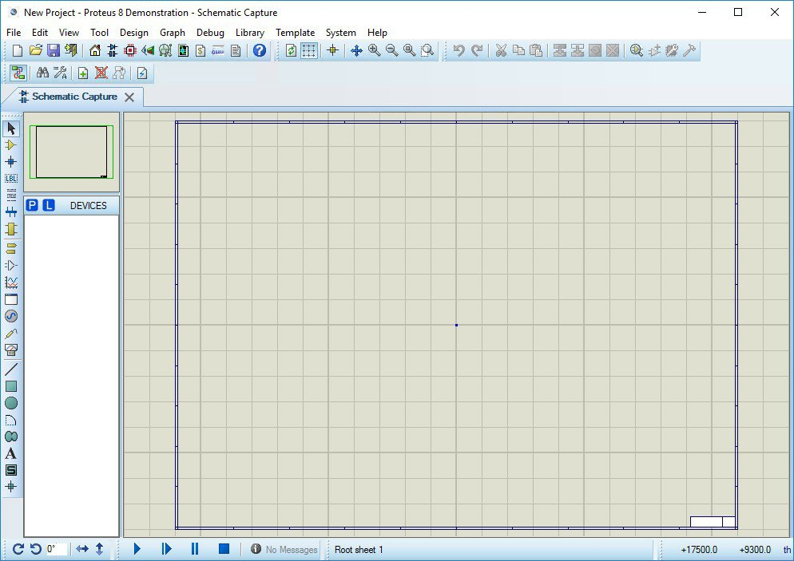
Layout

Slide 18
Layout
Editing Window
The dotted portion is called an editing window. This is a drawing portion of proteus where you simulate the circuits and projects.
Overview Window
In the overview window, you see the complete view of your complete design.
Object Selector
This section has 2 buttons P and L. P is used to select different components and shown in this box. The L button is for libraries.

Slide 19
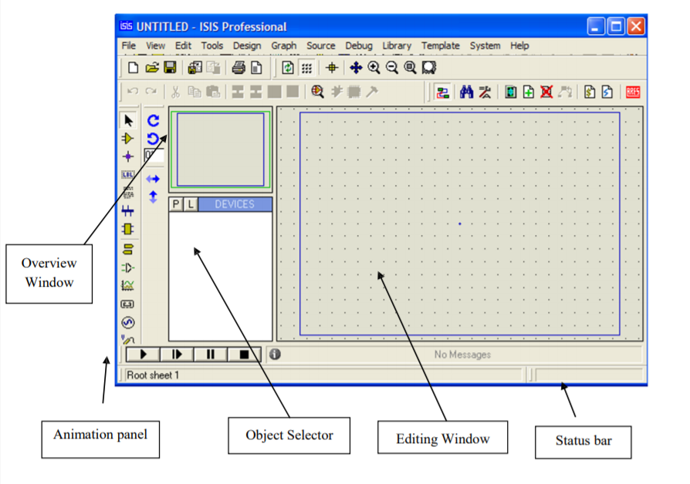

Slide 20
Layout
Zoom Option
By using this option you can easily zoom in and zoom out your layout and can observe complete simulation very clearly.
Tool Option
By using this option you can select different devices like voltmeter, ammeter, oscilloscope, etc.
Run Buttons
At the left bottom there are 4 buttons Run, advance, pause and stop. These buttons are like the remote control and on and off your circuit.

Slide 21
Fill in the blanks
Object component has 2 buttons P and L; L stands for _______

Slide 22
Quiz Time
Fill in the blanks
Object component has 2 buttons P and L; L stands for LIBRARIES

Slide 23
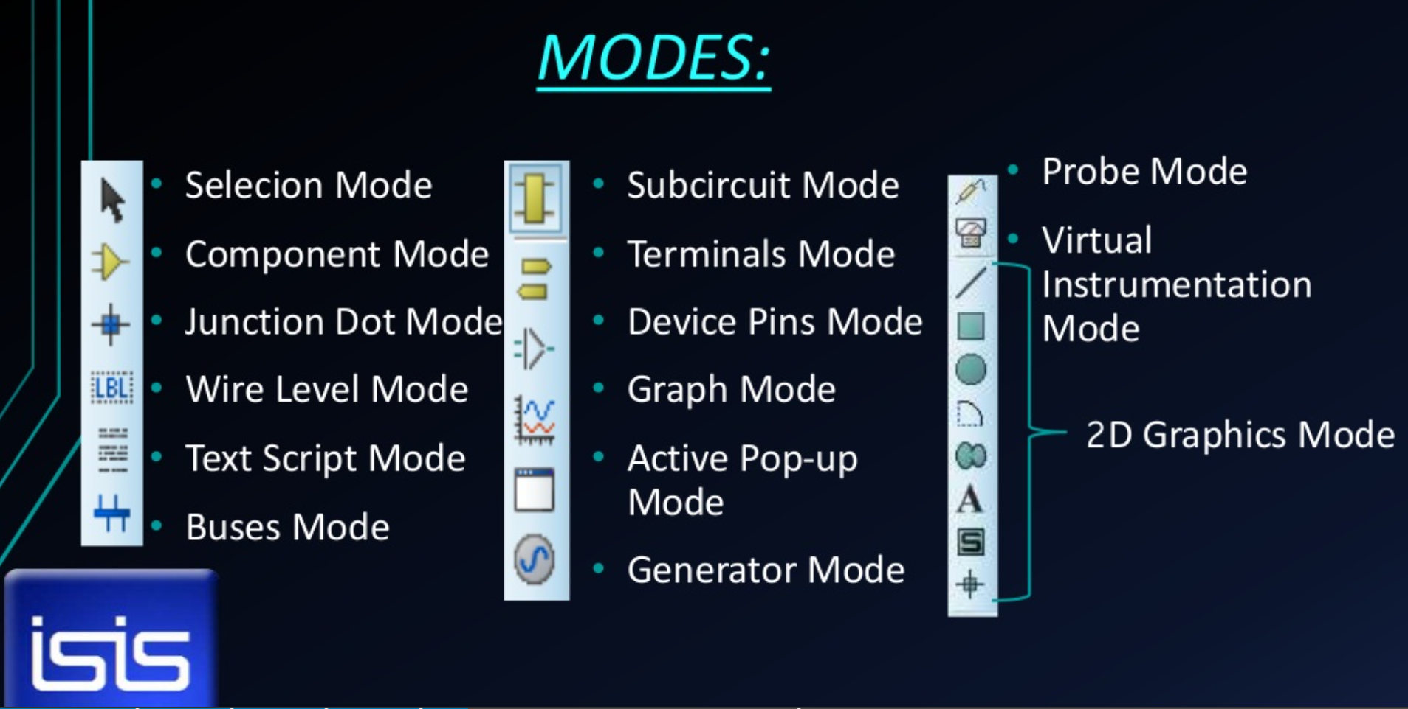

Slide 24
Modes
Component Mode: P => Pick Device & L => Library
Subcircuit Mode: Different Ports, like- Input, Output, Bidir, Power, Ground & Bus.
Terminals Mode: Different Terminals, like- Input, Output, Bidir, Power, Ground & Bus.
Device Pins Mode: Invert, Posclk, Negclk, Short & Bus.
Graphs Mode: Analogue, Digital, Frequency, Transfer, Noise, Distortion, Fourier, Audio, Interactive, Conformance, DC Sweep & AC Sweep.

Slide 25
Modes
Generators Mode: DC, Sine, Pulse, Exp, SFFM, PWLIN, File, Audio, Dstate, Dedge, Dpulse, Dclock, Dpattern & Scriptable.
Probes Mode: Voltage, Current & Tape probe.
Instruments Mode: Oscilloscope, Logic Analyser, Counter Timer, Virtual Terminal, SPI Debugger, 12C Debugger, Signal Generator, Pattern Generator, DC-Voltmeter, DC-Ammeter, AC-Voltmeter & AC- Ammeter.

Slide 26
Choose correct option :
Input, Output, Ground, Power, Bus come under _________ mode.
Probes mode
Terminals mode
Graphs mode
Instruments mode

Slide 27
Choose correct option :
Input, Output, Ground, Power, Bus come under _________ mode.
Probes mode
Terminals mode
Graphs mode
Instruments mode

Slide 28
Choose correct option :
Voltmeter, Ammeter, Virtual Terminal, Pattern generator come under _________ mode.
Probes mode
Graphs mode
Terminals mode
Instruments mode

Slide 29
Choose correct option :
Voltmeter, Ammeter, Virtual Terminal, Pattern generator come under _________ mode.
Probes mode
Graphs mode
Terminals mode
Instruments mode

Slide 30
Points to be discussed
How to Select Proper component for the designed circuit?
How to make Schematic?
Making the PCB layout.
3D view to the designed pcb

Slide 31
Attaching HEX file
The next stage is to attach the HEX file to our design in order to successfully simulate the design.
We do this through the following steps.

Slide 32
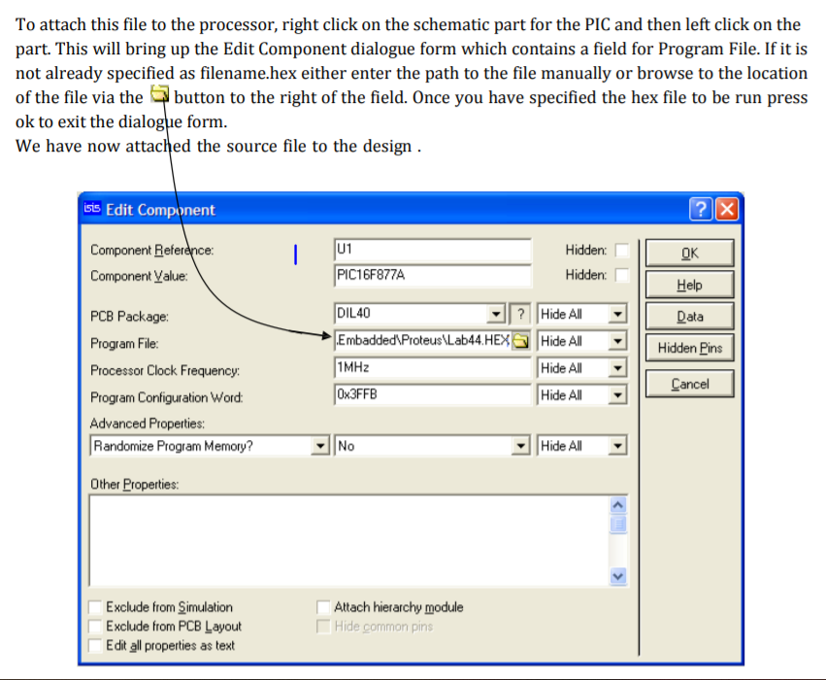

Slide 33
Fill in the blanks :
The file we attach to our design is called ___ file.

Slide 34
Fill in the blanks :
The file we attach to our design is called HEX file.

Slide 35
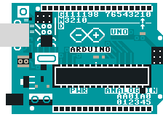
Introduction to Arduino

Slide 36
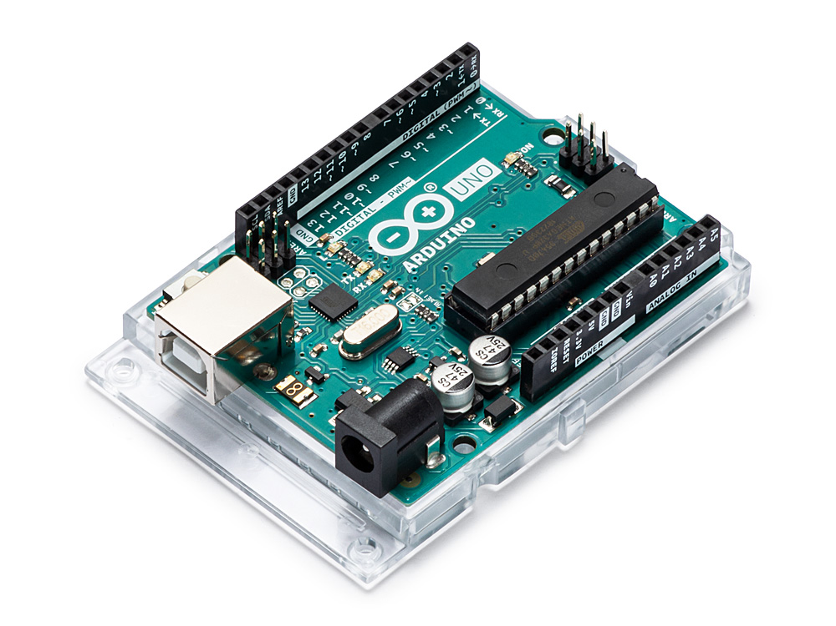
Arduino UNO
Arduino Uno is a microcontroller board based on the ATmega328P.
It has 14 digital input/output pins.
And 6 analog pins.
It contains everything needed to support the microcontroller; simply connect it to a computer with a USB cable or power it with a AC-to-DC adapter or battery to get started.

Slide 37
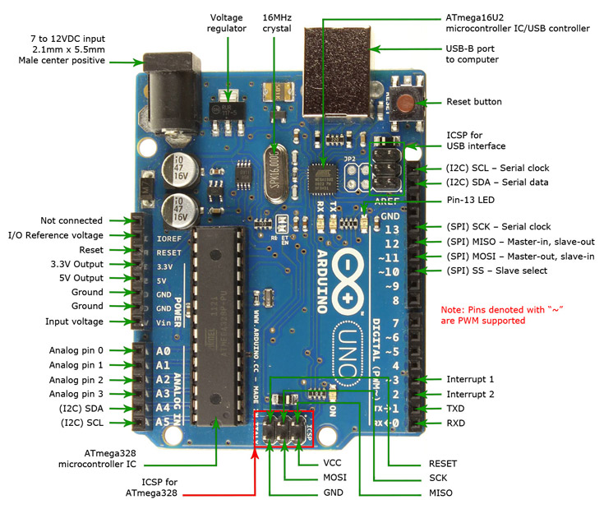
Features of
Arduino UNO
The operating voltage is 5V.
The recommended input voltage will range from 7v to 12V.
The input voltage ranges from 6v to 20V.
Digital input/output pins are 14.
Analog i/p pins are 6.
DC Current for each input/output pin is 40 mA.
DC Current for 3.3V Pin is 50 mA.
Flash Memory is 32 KB.

Slide 38
Fill in the blanks :
Arduino UNO has __ digital pins and
___ analog pins.
14 and 8
16 and 6
16 and 8
14 and 6

Slide 39
Fill in the blanks :
Arduino UNO has __ digital pins and
___ analog pins.
14 and 8
16 and 6
16 and 8
14 and 6

Slide 40
Project using
Pressure and Temperature sensor

Slide 41
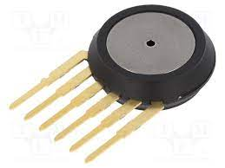
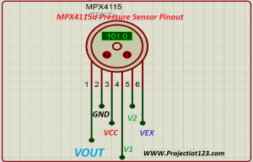
Pressure Sensor :
MPX411a

Slide 42
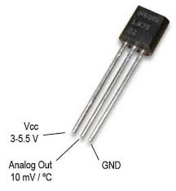
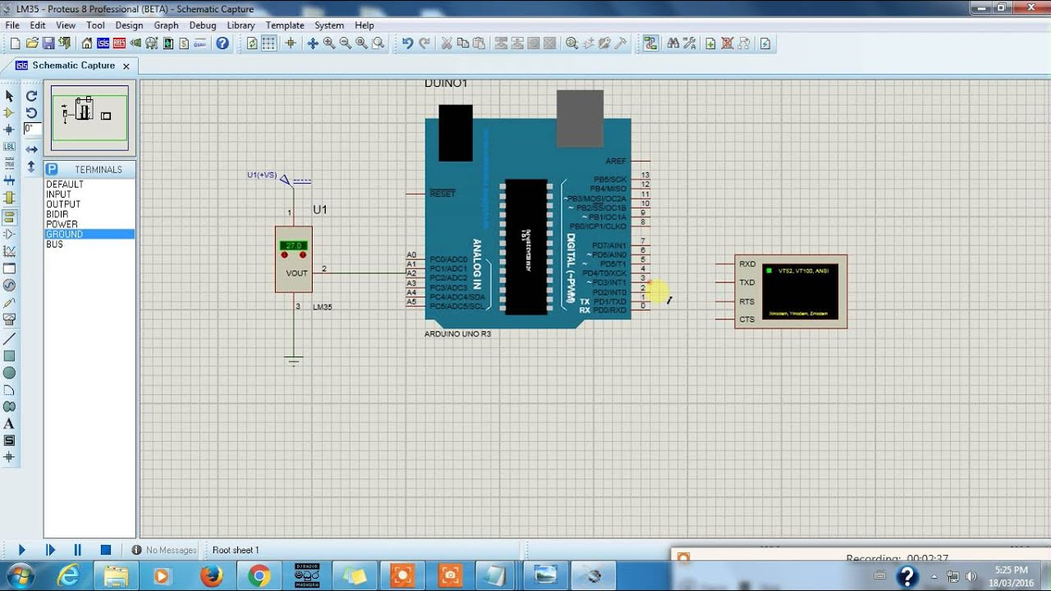
Temperature Sensor :
LM35

Slide 43
Let’s get started…..
Let’s create a project using these 2 sensors

Slide 44
Steps
Pick Arduino UNO by typing uno
Pick LM35 temperature sensor
Pick MPX4115 pressure sensor
Connections of pressure sensor :
Pin 1 -> Arduino Analog Pin 0
Pin 2 -> Ground
Pin 3 -> Power
Connections of temperature sensor :
Pin Vout -> Arduino Analog pin 1
Bottommost pin -> Ground
Topmost pin -> DC generator with V=5v
Connections of virtual terminal :
RXD -> TX
TXD -> RX

